Slide 2
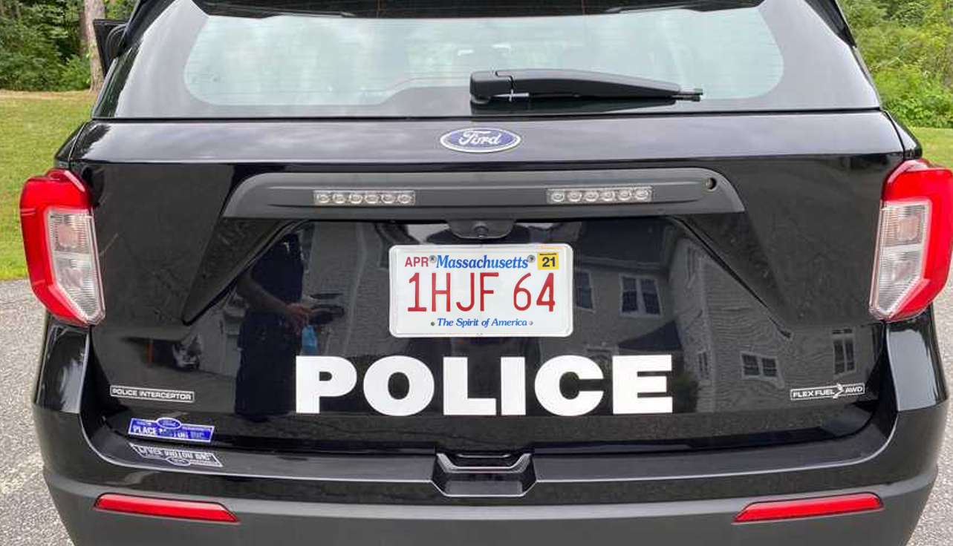
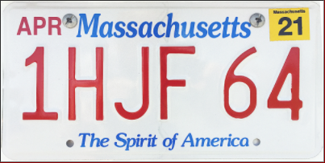
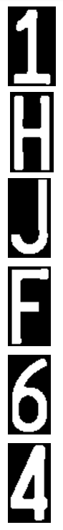

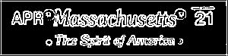
Overview
Rectangle
detection
candidates
Size/Shape Filter
PVN
Plate Validation Net
Extract top and bottom parts
- Grayscale
- Edge detection - Binarization
1 H J F 6 4
CRN
Char Recognition Net
Character segmentation
Serial extraction
RGB/HSV Info
MA
SRN
State Recognition Net

Slide 3
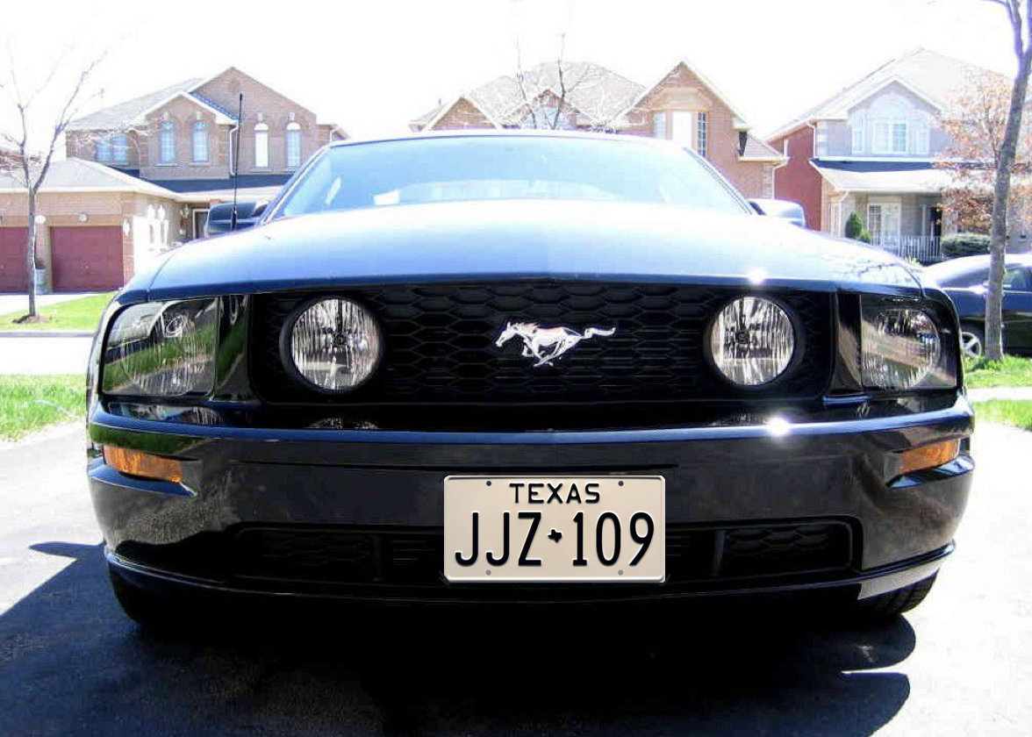
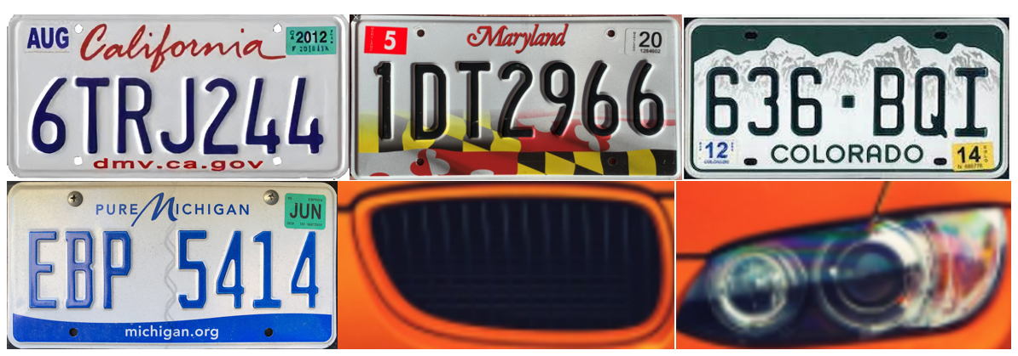
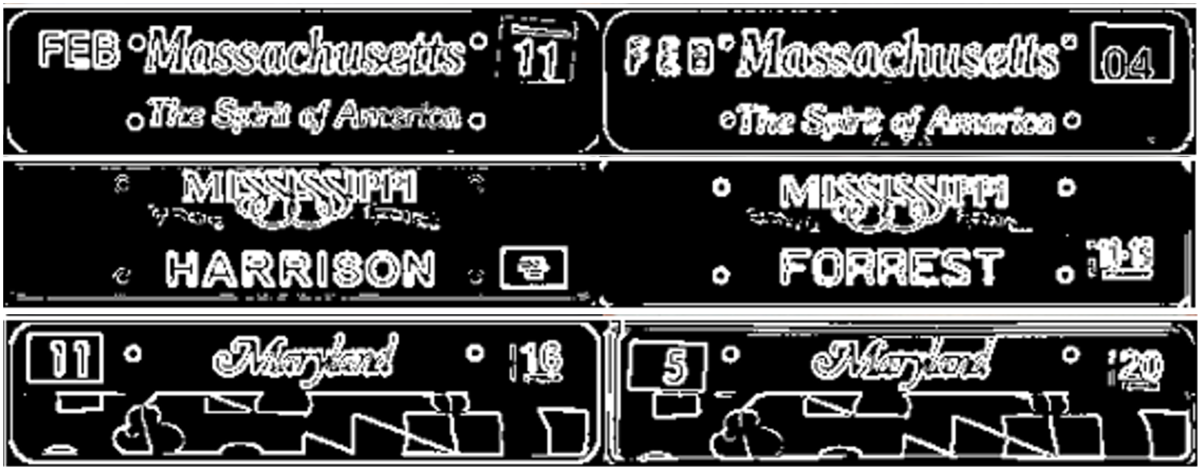
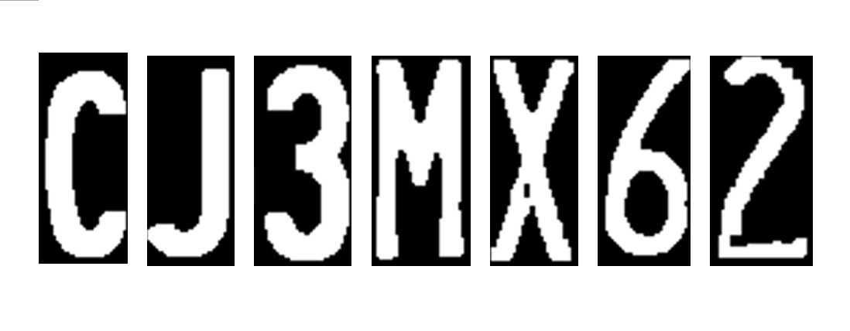
Dataset Manufacturing
Only used for overall test
Derived
PVN
Plate Validation Net
SRN
State Recognition Net
CRN
Char Recognition Net

Slide 4
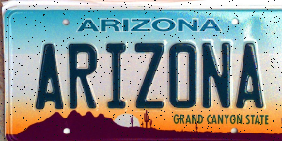
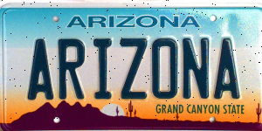

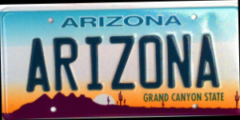
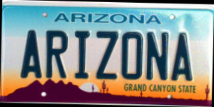
Dataset Manufacturing
No perfect clarity?
No perfect angle?
Add random noise
Add rotations

Slide 6
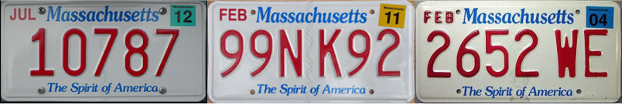
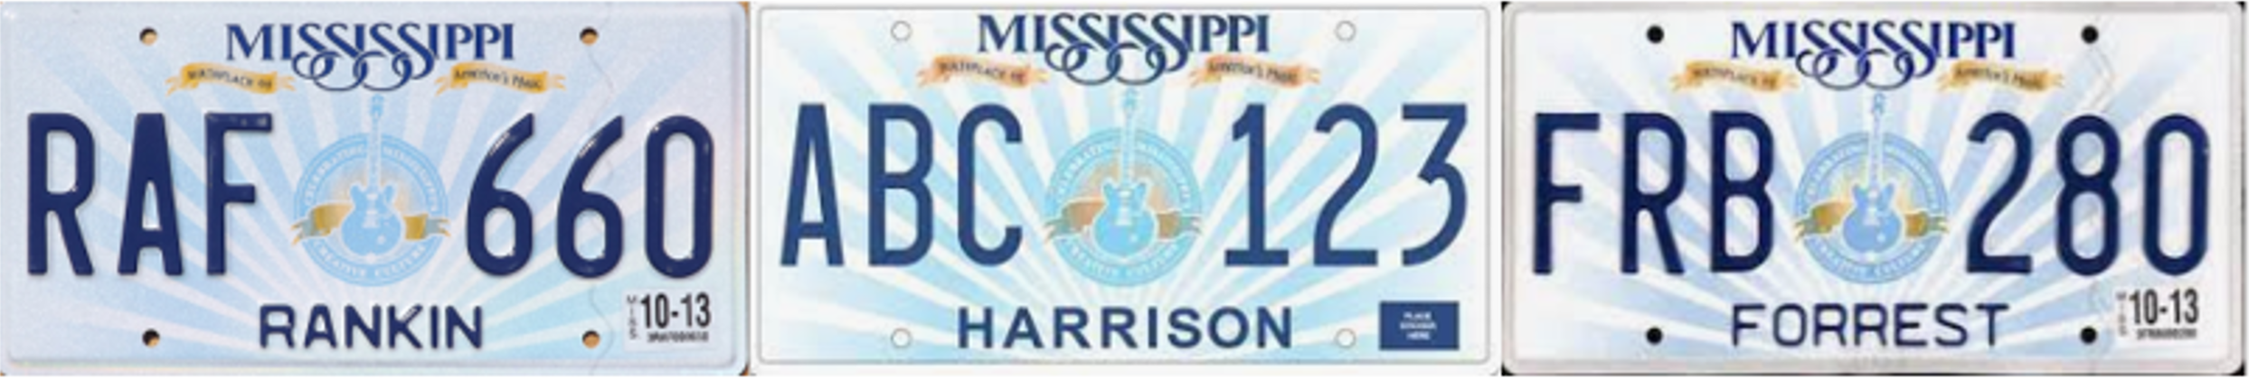
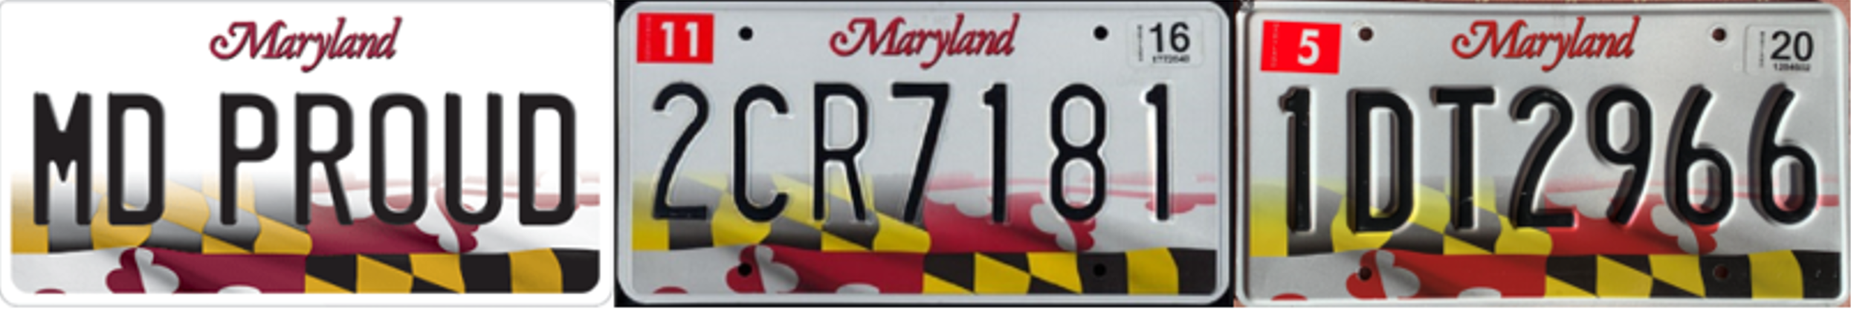
State Recognition and Serial Extraction
Three important properties
Format & Pattern are stable
Serial colors are consistent
Serial colors are different from the background

Slide 7
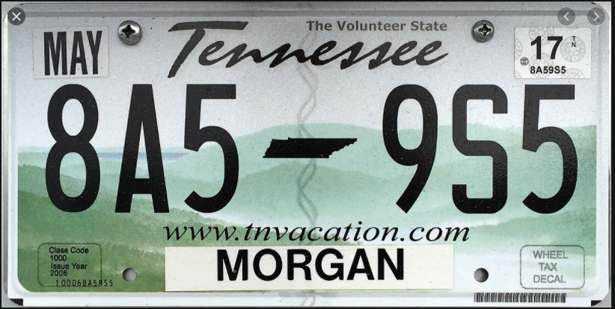
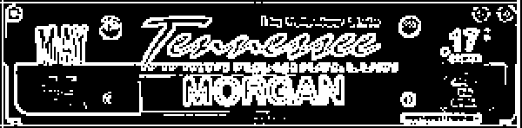
State Recognition and Serial Extraction
State features area
Edge detection & binarization
> 127 ➔ 255
<= 127 ➔ 0
SRN
State Recognition Net
Result: TN
Feature image

Slide 8
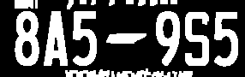
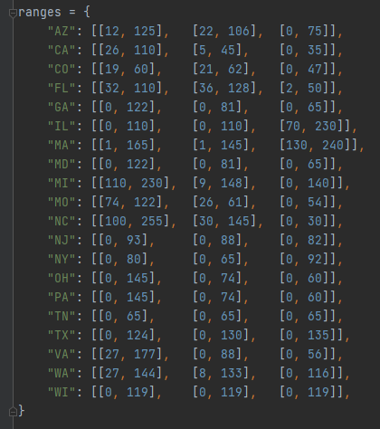
State Recognition and Serial Extraction
Serial area
TN: [[0, 65], [0, 65], [0, 65]]
Look up to
Result: TN
State-color range table

Slide 9
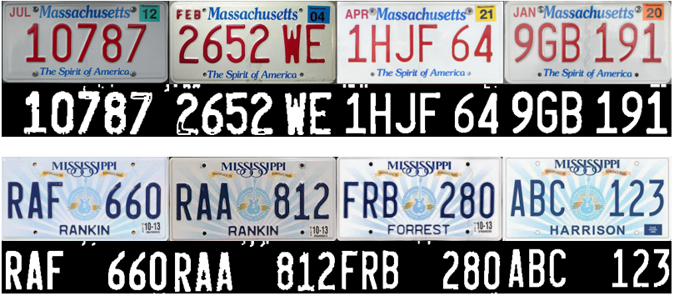
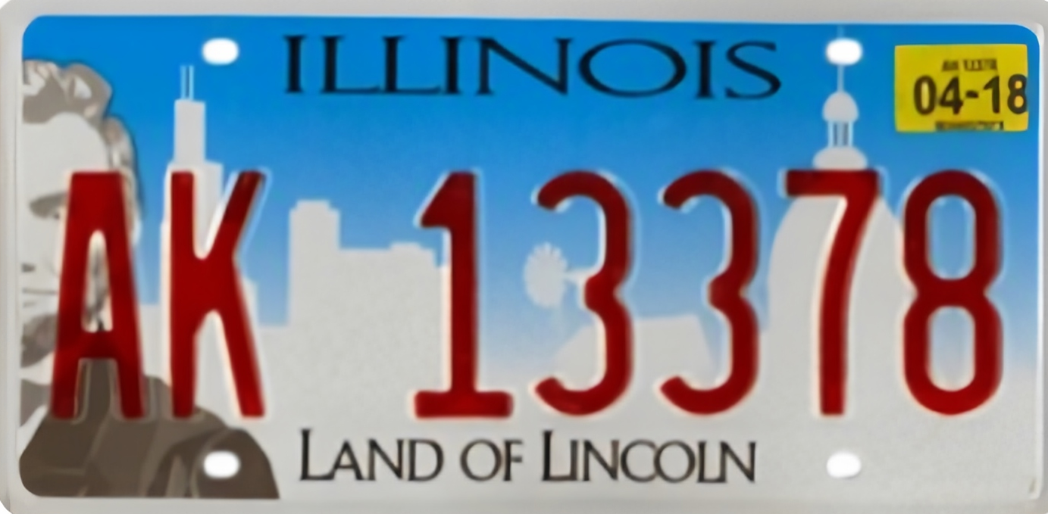
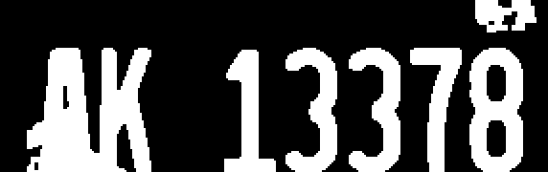
State Recognition and Serial Extraction
New and old license plates and the different illumination
Properly widened RGB range
Too-wide RGB range

Slide 12
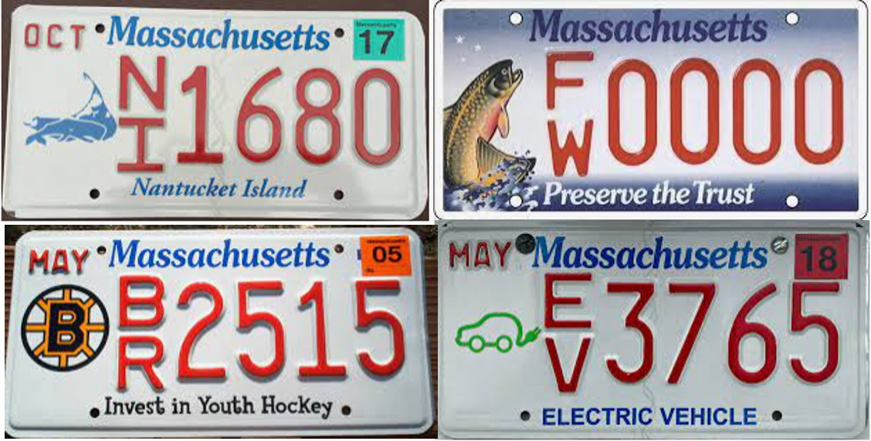
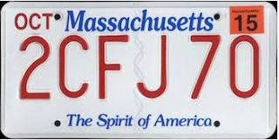
Future Works
1. Improvement of universality
- More states (currently we only deal with the top-20 states with the most population)
- More patterns (people may have various customized plates and different versions)

Slide 13
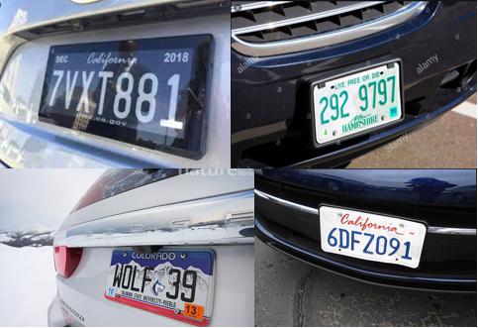
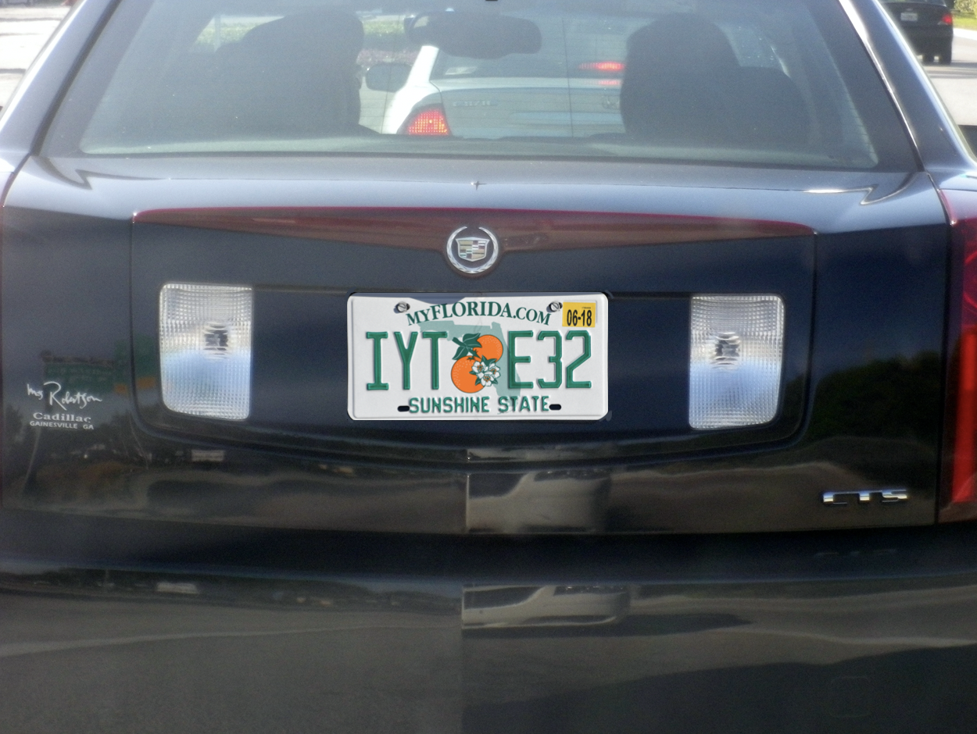
Future Works
2. Various conditions
Currently the condition we assume/restrict is that the recognition happens at the entrance/exit of a parking lot.
- Not perfect angle
- Extreme weather conditions

Slide 14
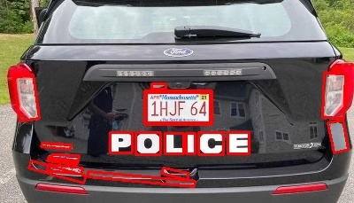
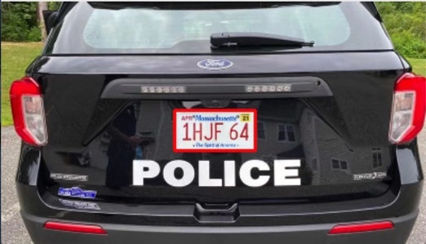
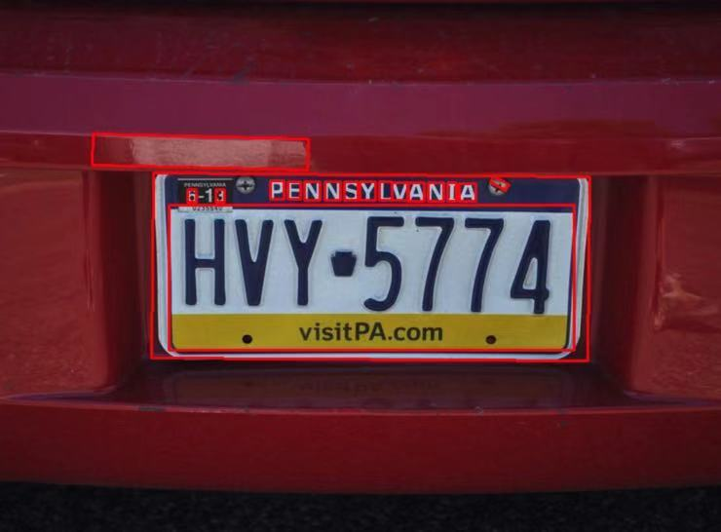
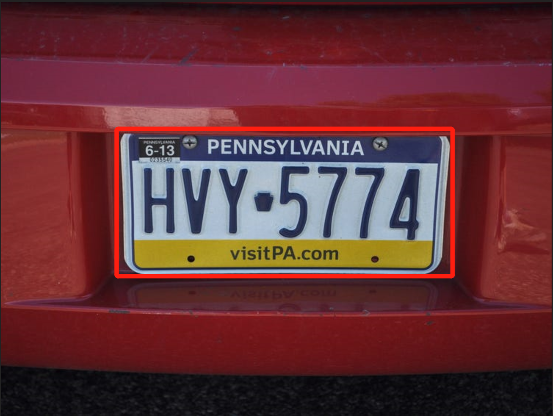
Future Works
3. More robust plate detection
We may consider using YOLO Net in the future to directly detect plate in an image

